Slide 1
MANB2153 MACHINE LEARNING FOR BUSINESS PROBLEMS
Siti Sophiayati Yuhaniz
Week 1-Lab Session

Slide 2
Outline
Github
Python installation
Jupyter Notebook
Python Introduction and Review

Slide 3
Github
Everyone should have a Github account
Refer to Github documentation on how to set up
Put your github account links at our Wiki page

Slide 4
Python Installation
https://www.anaconda.com/download/
https://medium.com/@GalarnykMichael/install-python-on-windows-anaconda-c63c7c3d1444

Slide 5
Jupyter Notebook
At the terminal, go to your fav directory, e.g. d:/MANB2153, type jupyter notebook to open jupyter notebook at your browser
Or just click Jupyter Notebook at Anaconda Navigator

Slide 6
Python Review
http://learnpython.org/
Hello World
Variables
Simple calculation
Function
* Demonstrate this on your Jupyter Notebook, and push to your Github

Slide 7
End to End Machine Learning Project

Slide 8
Machine Learning Project Checklist
Frame the problem and look at the big picture.
Get the data.
Discover and visualize the data to gain insights.
Prepare the data for Machine Learning algorithms.
Select a model and train it.
Fine-tune your model.
Present your solution.
Launch, monitor, and maintain your system.

Slide 9
Common Data sets
UC Irvine Machine Learning Repository
Kaggle datasets
Amazon’s AWS datasets
Meta portals (they list open data repositories):
http://dataportals.org/
http://opendatamonitor.eu/
http://quandl.com/

Slide 10
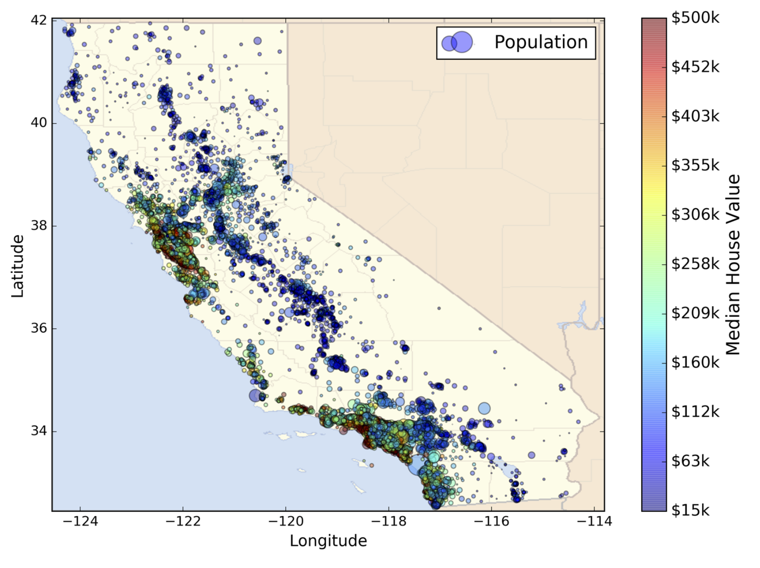
Build a model of housing prices in California using the California census data

Slide 11
Machine Learning Housing Corporation!
Welcome to Machine Learning Housing Corporation! The first task you are asked to perform is to build a model of housing prices in California using the California census data. This data has metrics such as the population, median income, median housing price, and so on for each block group in California. Block groups are the smallest geographical unit for which the US Census Bureau publishes sample data (a block group typically has a population of 600 to 3,000 people). We will just call them “districts” for short.
Your model should learn from this data and be able to predict the median housing price in any district, given all the other metrics.

Slide 12
1. Frame the problem and look at the big picture.
Frame the problem
Building a model is probably not the end goal.
How does the company expect to use and benefit from this model?
This is important because it will determine how you frame the problem, what algorithms you will select, what performance measure you will use to evaluate your model, and how much effort you should spend tweaking it.

Slide 13
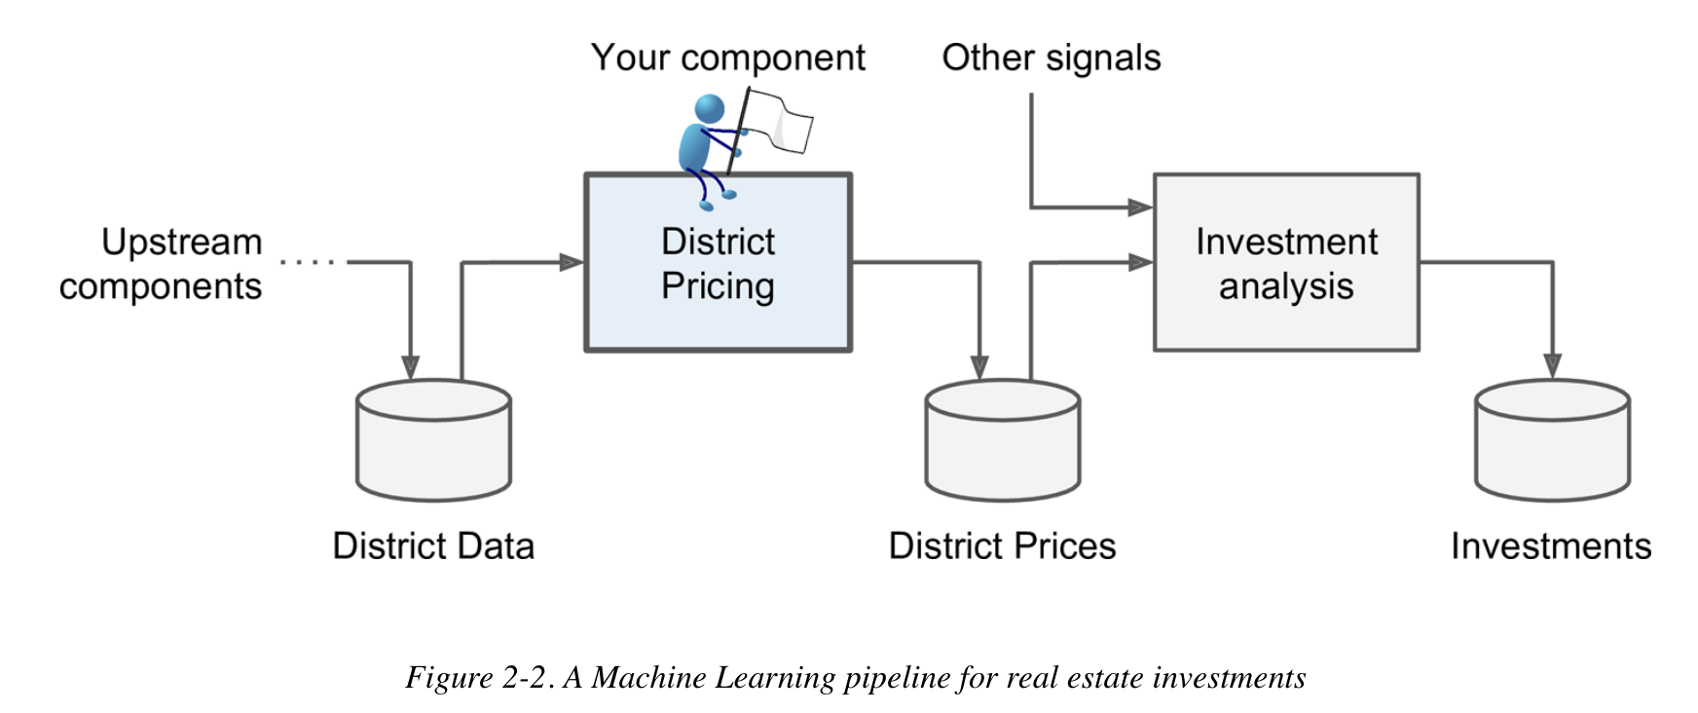
So your boss said…
“your model’s output will be fed to another ML system”
A sequence of data processing components is called a data pipeline.

Slide 14
More Questions…
What is the current solution?
Supervised, unsupervised or reinforcement learning?
Classification or regression task?
Batch Learning or online learning?

Slide 15
Possible answers to q1…
The next question to ask is what the current solution looks like (if any). It will often give you a reference performance, as well as insights on how to solve the problem. Your boss answers that the district housing prices are currently estimated manually by experts: a team gathers up-to-date information about a district (excluding median housing prices), and they use complex rules to come up with an estimate. This is costly and time-consuming, and their estimates are not great; their typical error rate is about 15%.

Slide 16
More Answers…
it is clearly a typical supervised learning task since you are given labeled training examples (each instance comes with the expected output, i.e., the district’s median housing price).
Moreover, it is also a typical regression task, since you are asked to predict a value. More specifically, this is a multivariate regression problem since the system will use multiple features to make a prediction (it will use the district’s population, the median income, etc.). Btw, what is univariate regression?
Finally, there is no continuous flow of data coming in the system, there is no particular need to adjust to changing data rapidly, and the data is small enough to fit in memory, so plain batch learning should do just fine.

Slide 17
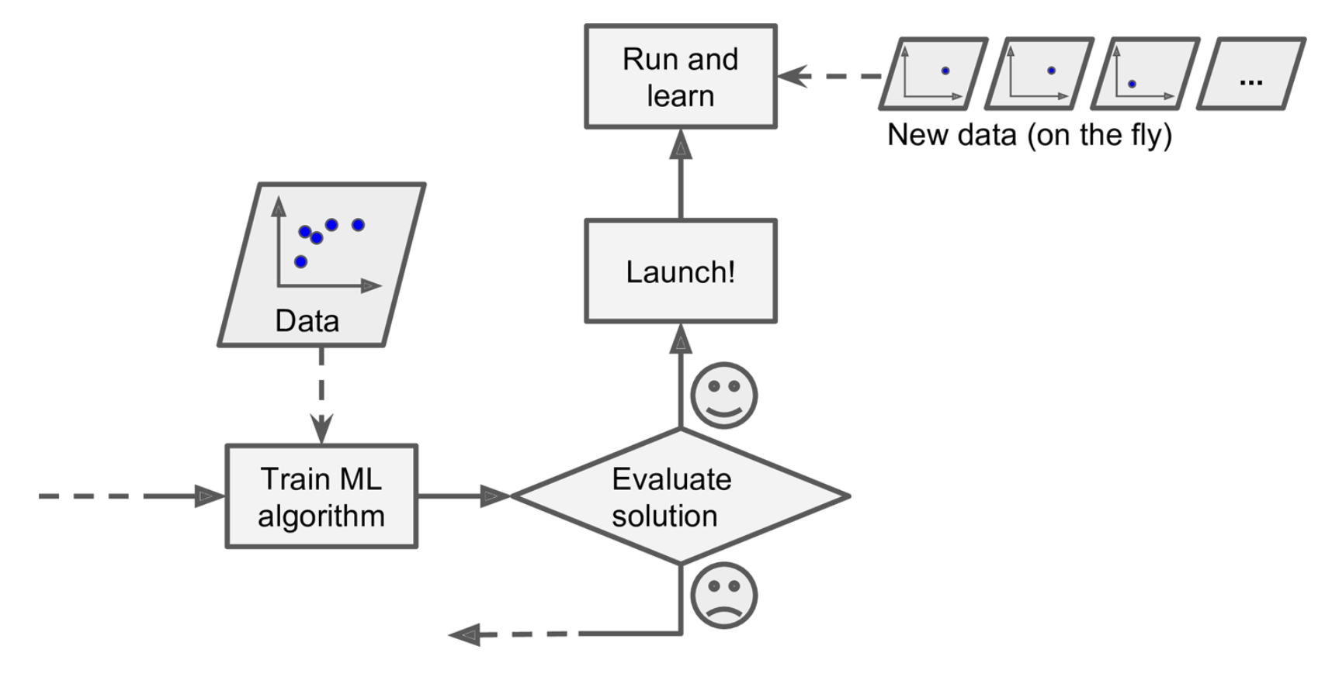
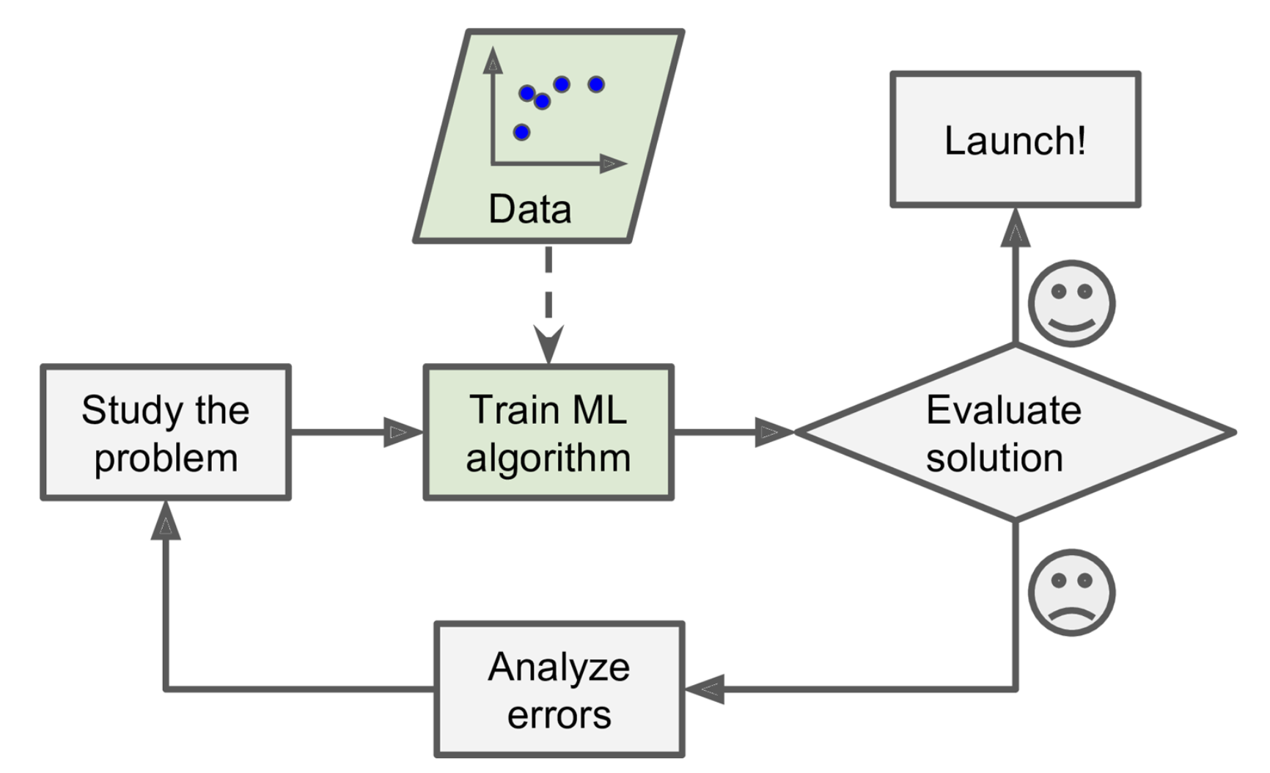
Batch vs online learning
Online-learning
Batch-learning

Slide 18
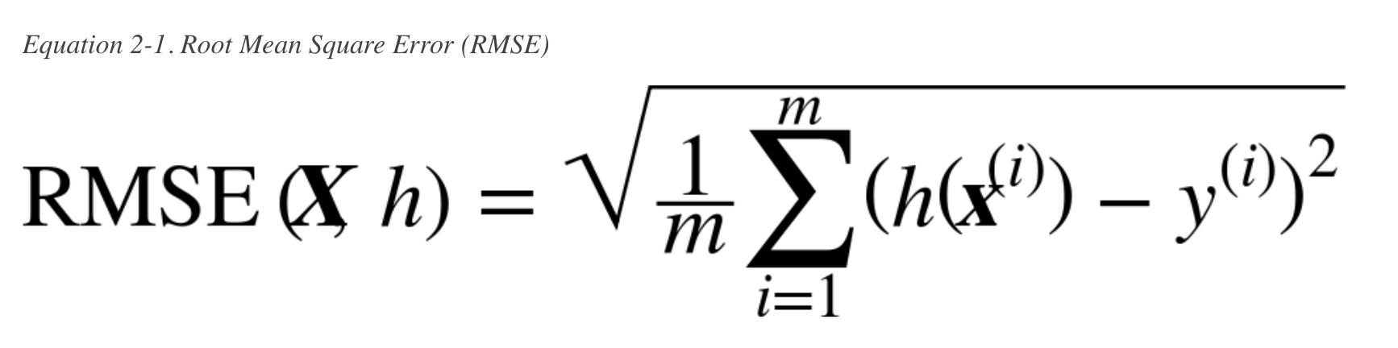
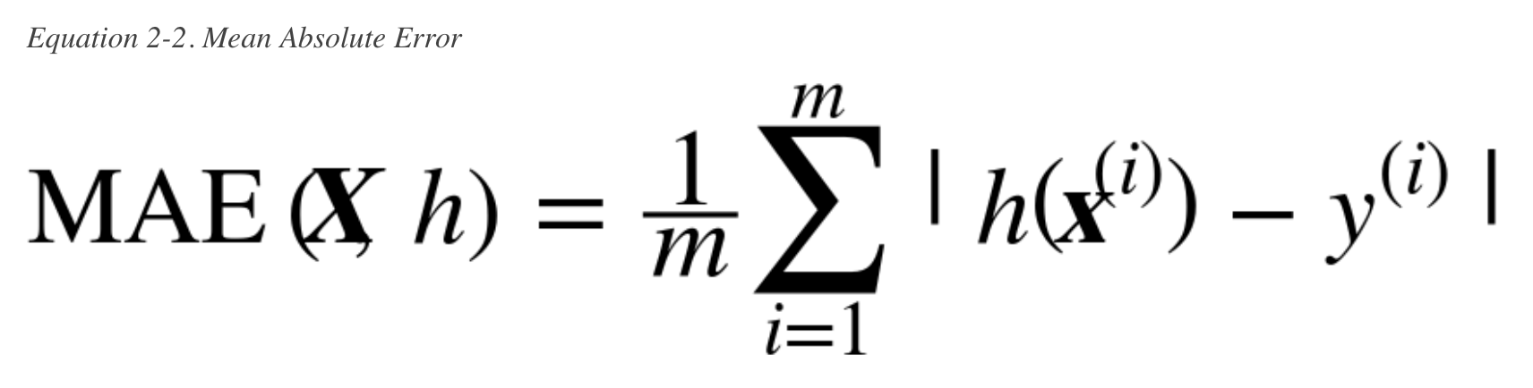
Select a Performance Measure
A typical performance measure for regression problems is the Root Mean Square Error (RMSE).

Slide 19
2. Get the Data

Slide 20
Thanks!
Siti Sophiayati Yuhaniz, PhD
Machine Learning for Data Science Interest Group Advanced Informatics School Universiti Teknologi Malaysia
@utmmlds
ais.utm.my/mlds
September 2017

